Slide 1
Creating resources for the development of reading skills in Polish at ab initio level
Marta Becquet,
School of Modern Languages
and Cultures,
University of Glasgow

Slide 2
Texts in SL teaching
Teksty prymarne (original texts) to teksty autentyczne, nie są przeznaczone dla celów dydaktycznych;
teksty adaptowane (simplified/adapted texts)są przystosowane przez uproszczenie i zredukowanie leksyki oraz trudniejszych struktur składniowych i gramatycznych;
teksty sekundarne (prepared texts) są preparowane, opracowywane specjalnie dla celów dydaktycznych; służą do zilustrowania zjawisk gramatycznych, zaprezentowania nowych jednostek leksykalnych lub przekazania pewnych wiadomości realioznawczych.
(Kozłowski, 1991: 14-15)

Slide 3
Simplified texts in SL teaching
adaptacja sensu stricto:
adaptacja eliminująca (simplification by elimination),
adaptacja modyfikująca (simplification by modification);
adaptacja sensu largo:
adaptacja selektywna (selective simplification),
adaptacja komplementarna (complimentary simplification).
(Kozłowski, 1991:31-32)

Slide 4
Extensive reading
Well-balanced language course divides
time equally between four strands:
meaning-focused input,
meaning-focused output,
language-focused learning,
fluency development.
(I.P.S. Nation, 2009:1)
Extensive reading fits into the meaning-
focused input and fluency development
strands of a course. (I.P.S. Nation, 2009:49)

Slide 5
Graded readers
Extensive reading may be based on
graded readers.
Graded readers are extended texts, mostly fiction, written in language reduced in terms of structures and vocabulary.
(D.R. Hill, 1997:57)

Slide 6
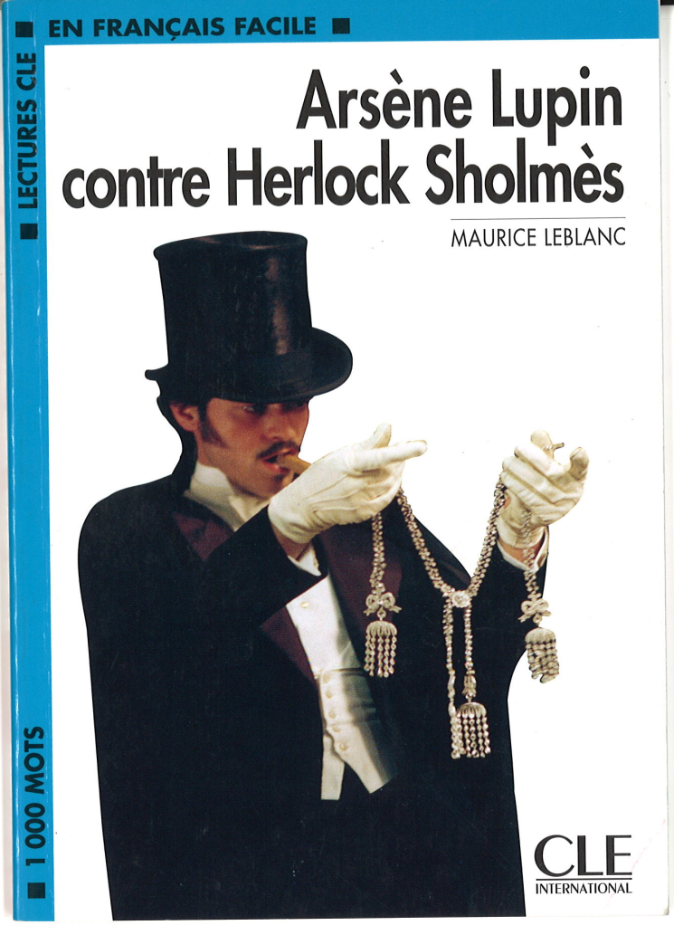
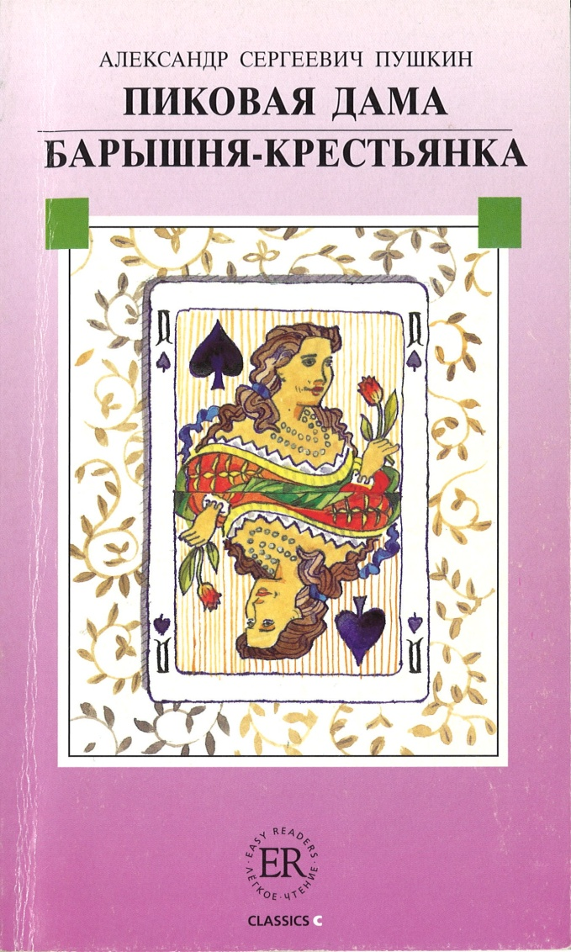
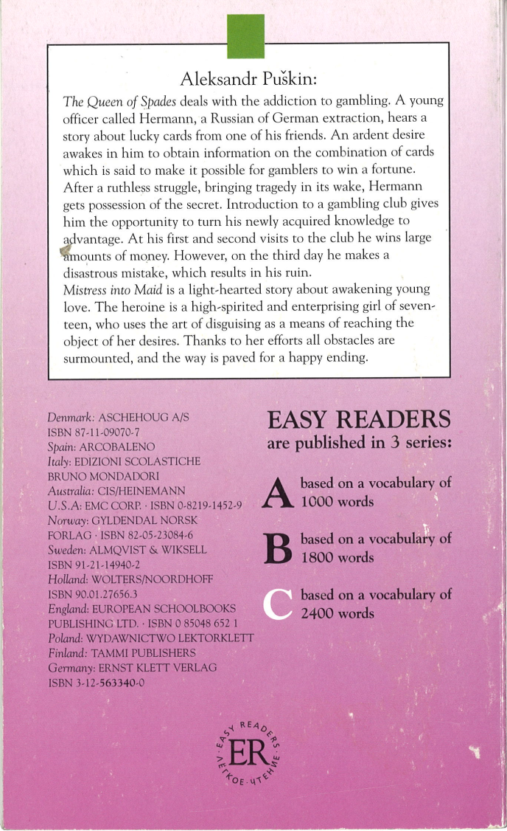
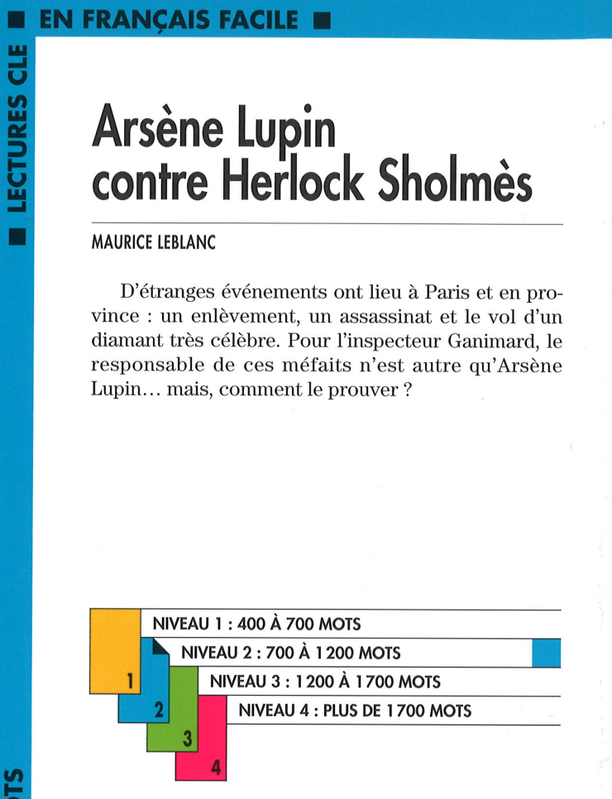
Graded readers - examples

Slide 7
Why graded readers for learners of Polish language?
to encourage students to read other texts (apart from textbooks),
to support development of interest in Polish language and culture,
to promote literature/to introduce students to literature studies.

Slide 8
Language of graded readers
wordlists and structure lists,
word count: EPER database
Near Beginner, 300-500 words, artwork/page,
Elementary, 800-1,000 words,
4-5000 words,
Intermediate, 1,200-1,600 words,
6-12,000 words,
Upper, 1,800-2,200 words, 14-22,000 words,
Advanced, 2,500-3,500 words,
25-35,000 words.
(D.H. Hill, 2007:67)

Slide 9
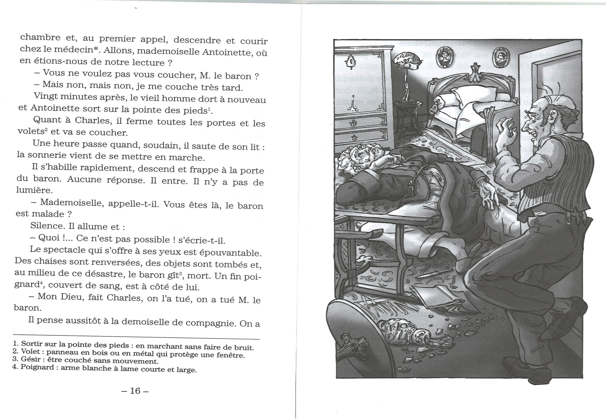
Language of graded readers Illustrations and glossing

Slide 10
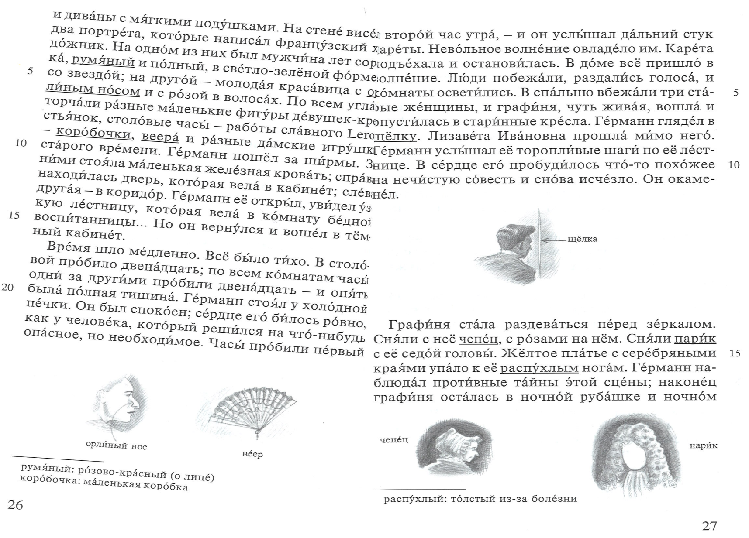
Language of graded readers Illustrations and glossing

Slide 11
Literature and graded readers
In what ways can literary texts be adapted for students at beginners level?
Which literary texts may be used for such adaptations?

Slide 12
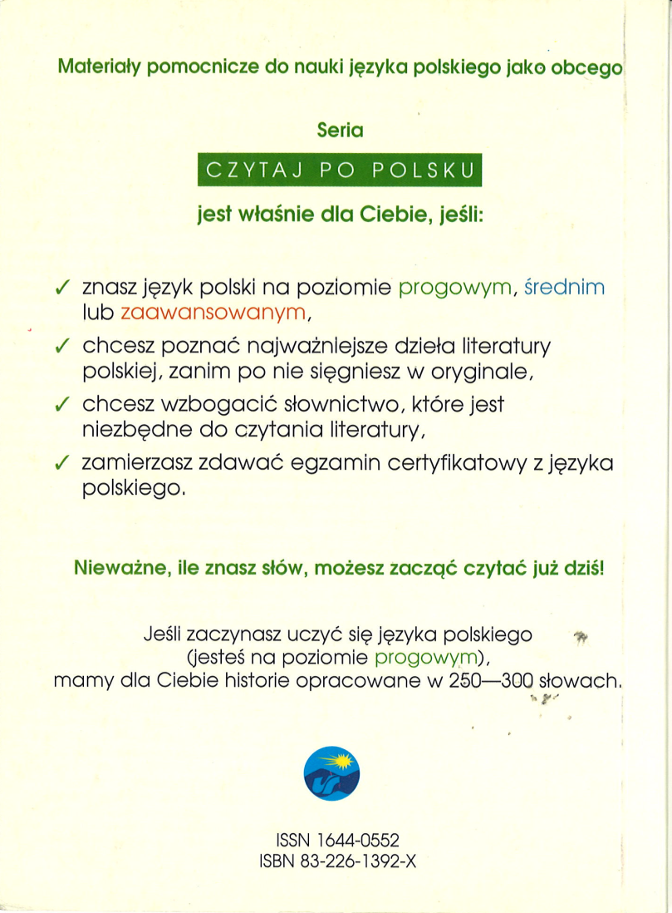
Polish graded reader?

Slide 13
Polish graded reader?

Slide 14
So, what now?
Do graded readers enough help to be introduced into the learning process?
Which of the general guidelines for creating graded readers could be the most beneficial for learners of Polish?
What are the most important features of the text that make it approachable for beginners?
Are students interested at all in reading such adaptations?
Which literary texts could be used for adaptation?
In what ways does the fall of communism influence Polish discussion of the literary canon?

Slide 15
Thank you for your attention! Dziękuję za uwagę!

